Slide 1
Scatter Graphs and Correlation

Slide 2
We have some BIVARATE Data
Student | Core | Stats
A | 42 | 41
B | 21 | 16
C | 25 | 36
D | 32 | 29
E | 34 | 35
F | 2 | 24
G | 23 | 22
H | 40 | 47
I | 20 | 30
J | 16 | 20

Slide 3
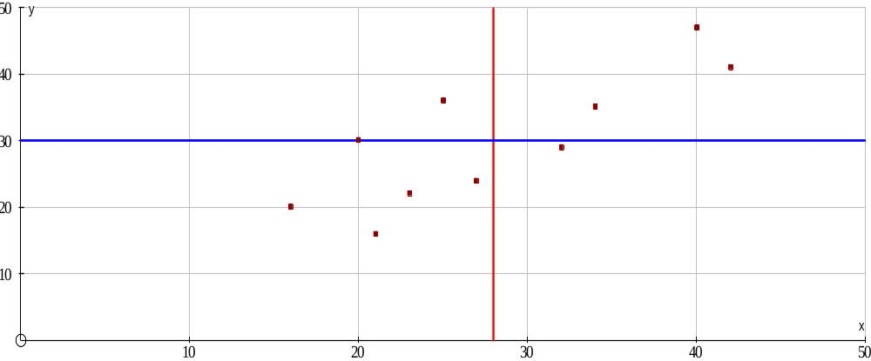
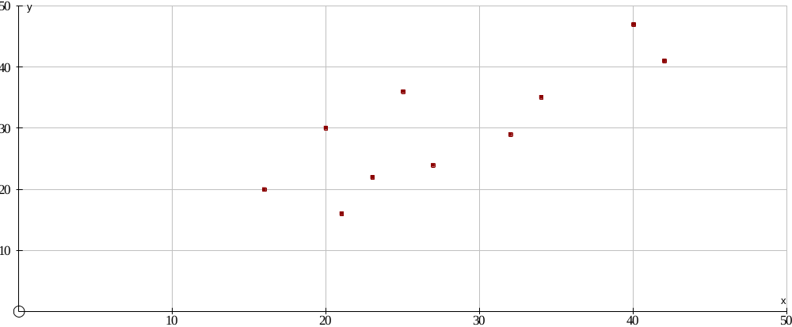
Student | Core | Stats
A | 42 | 41
B | 21 | 16
C | 25 | 36
D | 32 | 29
E | 34 | 35
F | 2 | 24
G | 23 | 22
H | 40 | 47
I | 20 | 30
J | 16 | 20
x_{i}-x
y_{i}-y
14 | 11
-7 | -14
-3 | 6
4 | -1
6 | 5
-1 | -6
-5 | -8
12 | 17
-8 | 0
-12 | -10
154
98
-18
-4
30
6
40
204
0
120
So the average distance from the 2 means is
630 /10 = 63
This is the covariance
Total | 630

Slide 4
The trouble is the covariance changes if the scale changes…
Try drawing a scatter graph for the same data but use percentages rather than raw scores.
Calculate the covariance this time.
It appears as though the scatter graph is the same but the covariance had changed.

Slide 5
So to standardise we divide by the products of the standard deviation.
Student | Core | Stats | (xi-x)2 | (yi-y)2 | (xi-x)(yi-y)
A | 42 | 41 | 196 | 121 | 154
B | 21 | 16 | 49 | 196 | 98
C | 25 | 36 | 9 | 36 | -18
D | 32 | 29 | 16 | 1 | -4
E | 34 | 35 | 36 | 25 | 30
F | 27 | 24 | 1 | 36 | 6
G | 23 | 22 | 25 | 64 | 40
H | 40 | 47 | 144 | 289 | 204
I | 20 | 30 | 64 | 0 | 0
J | 16 | 20 | 144 | 100 | 120
Sd = 8.27
Sd = 9.31

